Slide 1
03
Ensemble Learning

Slide 2

Ensemble Learning

Slide 3
Ensemble Learning
We regularly come across many game shows on television and noticed an option of “Audience Poll”. Most of the time a contestant goes with the option which has the highest vote from the audience and most of the time they win. We can generalize this in real life as well where taking opinions from a majority of people is much more preferred than the opinion of a single person.
The Ensemble technique has a similar underlying idea where we aggregate predictions from a group of predictors, which may be classifiers or regressors, and most of the time the prediction is better than the one obtained using a single predictor.

Slide 4
Definition -
Ensemble learning is a machine learning paradigm where multiple models (often called “weak learners”) are trained to solve the same problem and combined to get better results. The main hypothesis is that when weak models are correctly combined, we can obtain more accurate and/or robust models.
“A weak learner produces a classifier which is only slightly more accurate than random classification.”
The idea of ensemble methods is to try reducing bias and/or variance of such weak learners by combining several of them together to create a strong learner (or ensemble model) that achieves better performances.

Slide 5

Diagram of Ensemble Learning

Slide 6
Maths For Ensemble Learning
Let’s suppose we have ’n’ predictors/models:
Z1, Z2, Z3, ……., Zn with a standard deviation of σ
Variance(z) = σ²
If we use single predictors Z1, Z2, Z3, ……., Zn the variance associated with each will be σ² but the expected value will be the average of all the predictors.
Let’s consider the average of the predictors:
µ = (Z1 + Z2 + Z3+…….+ Zn)/n
If we use µ as the predictor then the expected value remains the same but see the variance now:
variance(µ) = σ²/n
So, the expected value remained ‘µ’ but variance decreases when we use an average of all the predictors.

Slide 7
This is why taking mean is preferred over using single predictors.
Ensemble methods take multiple small models and combine their predictions to obtain a more powerful predictive power.
Few very popular Ensemble techniques are -
Bagging
Boosting, and
Stacking

Slide 8
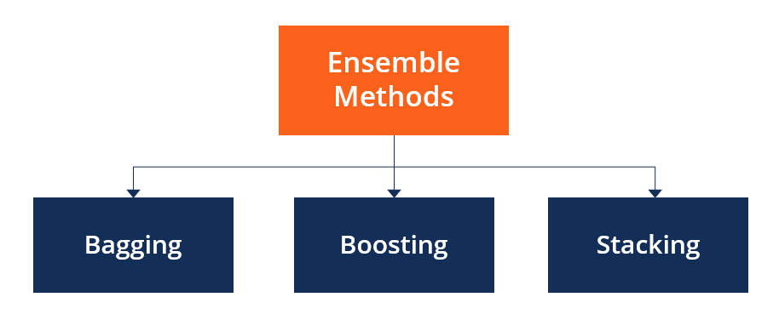
Types of Ensemble Learning / Methods

Slide 9
3.1
Bagging

Slide 10
Bagging
Bagging stands for Bootstrap Aggregation.
In real-life scenarios, we don’t have multiple different training sets on which we can train our model separately and at the end combine their result. Here, bootstrapping comes into the picture.
Bagging is the type of ensemble technique in which a single training algorithm is used on different subsets of the training data where the subset sampling is done with replacement (bootstrap). Once the algorithm is trained on all the subsets, then bagging predicts by aggregating all the predictions made by the algorithm on different subsets.

Slide 11
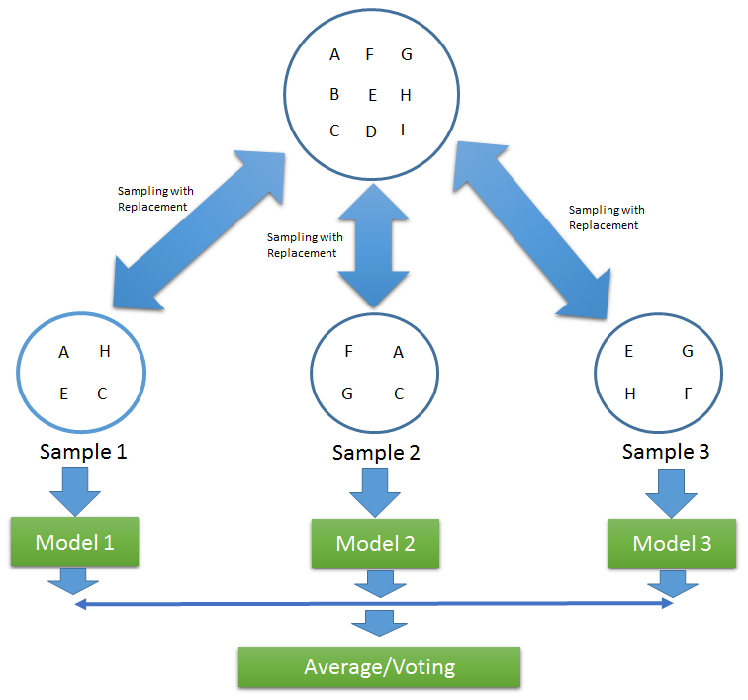
For aggregating the outputs of base learners, bagging uses majority voting (most frequent prediction among all predictions) for classification and averaging (mean of all the predictions) for regression.

Slide 12
Advantages of a Bagging Model:
1. Bagging significantly decreases the variance without increasing bias. Variance refers to how dependent the model is on the training data.
2. Bagging methods work so well because of diversity in the training data since the sampling is done by bootstrapping.
3. Also, if the training set is very huge, it can save computational time by training the model on a relatively smaller data set and still can increase the accuracy of the model.
4. Works well with small datasets as well.

Slide 13
Disadvantages of a Bagging Model:
1. it improves the accuracy of the model at the expense of interpretability i.e., if a single tree was being used as the base model, then it would have a more attractive and easily interpretable diagram, but with the use of bagging this interpretability gets lost.
2. Another is that during sampling, we cannot interpret which features are being selected i.e., there are chances that some features are never used, which may result in a loss of important information.

Slide 14
Few facts of a Bagging Model:
Out of Bag Evaluation: -In bagging, when different samples are collected, no sample contains all the data but a fraction of the original dataset. There might be some data that are never sampled at all. The remaining data which are not sampled are called out of bag instances.
The Random Forest approach is a bagging method where deep trees (Decision Trees), fitted on bootstrap samples, are combined to produce an output with lower variance.

Slide 15
3.2
Boosting

Slide 16
2. Boosting
Boosting is a method used in machine learning to reduce errors in predictive data analysis. Data scientists train machine learning software, called machine learning models, on labeled data to make guesses about unlabeled data. A single machine learning model might make prediction errors depending on the accuracy of the training dataset.
For example, if a cat-identifying model has been trained only on images of white cats, it may occasionally misidentify a black cat. Boosting tries to overcome this issue by training multiple models sequentially to improve the accuracy of the overall system.

Slide 17
Boosting methods work in the same spirit as bagging methods:
we build a family of models that are aggregated to obtain a strong learner that performs better. However, unlike bagging that mainly aims at reducing variance, boosting is a technique that consists in fitting sequentially multiple weak learners in a very adaptative way:
each model in the sequence is fitted giving more importance to observations in the dataset that were badly handled by the previous models in the sequence.

Slide 18
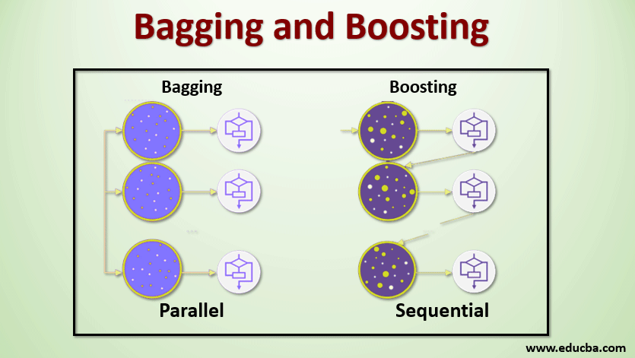
Bagging Vs Boosting

Slide 19
Bagging Vs Boosting
Ensemble learning can be performed in two ways:
Sequential ensemble, popularly known as boosting, here the weak learners are sequentially produced during the training phase. The performance of the model is improved by assigning a higher weightage to the previous, incorrectly classified samples. An example of boosting is the AdaBoost algorithm.
Parallel ensemble, popularly known as bagging, here the weak learners are produced parallelly during the training phase. The performance of the model can be increased by parallelly training a number of weak learners on bootstrapped data sets. An example of bagging is the Random Forest algorithm.

Slide 20
How Boosting algorithm works?
The basic principle behind the working of the boosting algorithm is to generate multiple weak learners and combine their predictions to form one strong rule.
These weak rules are generated by applying base Machine Learning algorithms on different distributions of the data set.
These algorithms generate weak rules for each iteration.
After multiple iterations, the weak learners are combined to form a strong learner that will predict a more accurate outcome.

Slide 21
Steps -
Step 1 - First assigns equal weight to each data sample. It feeds the data to the first machine model, called the base algorithm. The base algorithm makes predictions for each data sample.
Step 2- We assesses model predictions and increases the weight of samples with a more significant error. It also assigns a weight based on model performance. A model that outputs excellent predictions will have a high amount of influence over the final decision.
Step 3 - The algorithm passes the weighted data to the next decision tree.
Step 4 - The algorithm repeats steps 2 and 3 until instances of training errors are below a certain threshold.

Slide 22
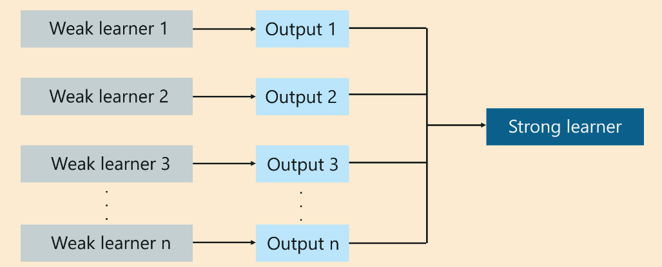
Diagram of Boosting

Slide 23
Advantage & Disadvantage
Advantages of a Boosting Model:
1. Boosting is a resilient method that curbs over-fitting easily.
2. Provably effective .
3. Versatile — can be applied to a wide variety of problems.
Disadvantages of a Boosting Model:
1. A disadvantage of boosting is that it is sensitive to outliers since every classifier is obliged to fix the errors in the predecessors. Thus, the method is too dependent on outliers.
2. Another disadvantage is that the method is almost impossible to scale up. This is because every estimator bases its correctness on the previous predictors, thus making the procedure difficult to streamline.

Slide 24
Types of Boosting
Adaptive Boosting or Ada Boosting
Gradient Boosting
XGBoost

Slide 25
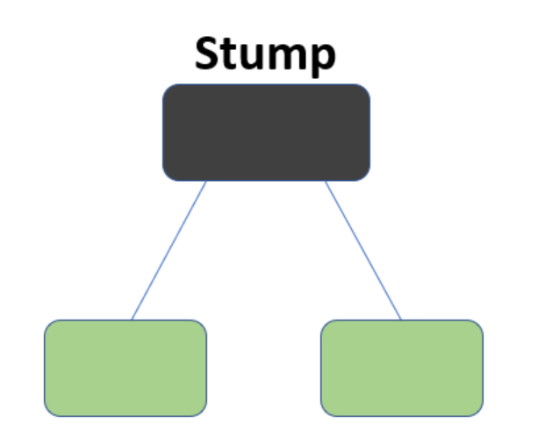
Ada Boosting
AdaBoost also called Adaptive Boosting is a technique in Machine Learning used as an Ensemble Method.
The most common algorithm used with AdaBoost is decision trees with one level that means with Decision trees with only 1 split. These trees are also called Decision Stumps.

Slide 26
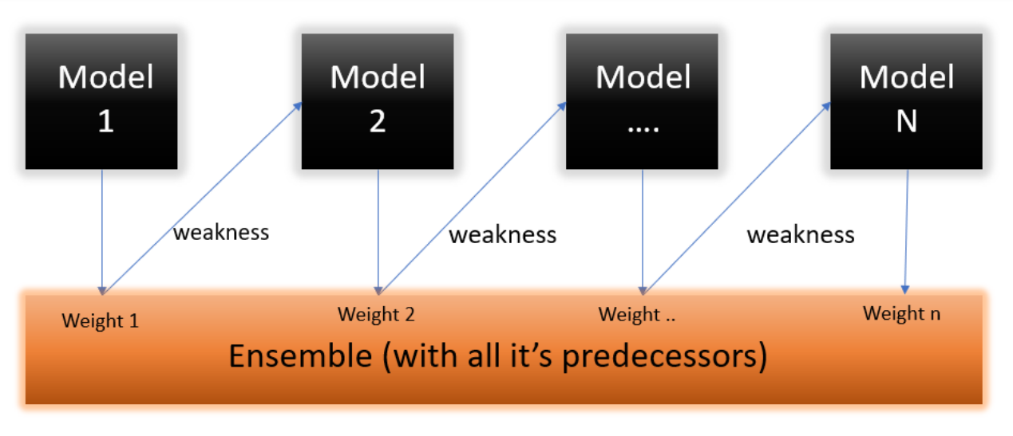
What this algorithm does is that it builds a model and gives equal weights to all the data points. It then assigns higher weights to points that are wrongly classified. Now all the points which have higher weights are given more importance in the next model. It will keep training models until and unless a lowe error is received.

Slide 27
When to use Ada Boosting
AdaBoost minimises loss function related to any classification error and is best used with weak learners. The method was mainly designed for binary classification problems and can be utilised to boost the performance of decision trees.

Slide 28

Using An Example To Explain The Algorithm
Step 1 – Since the target column is binary it is a classification problem. First of all these data points will be assigned some weights. Initially, all the weights will be equal.

Slide 29
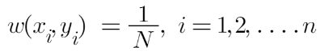
The formula to calculate the sample weights is:
Where N is the total number of datapoints
Here since we have 5 data points so the sample weights assigned will be 1/5.
Step 2 – We start by seeing how well “Gender” classifies the samples and will see how the variables (Age, Income) classifies the samples.
We’ll create a decision stump for each of the features and then calculate the Gini Index of each tree. The tree with the lowest Gini Index will be our first stump.
Let’s say Gender has the lowest gini index so it will be our first stump.

Slide 30
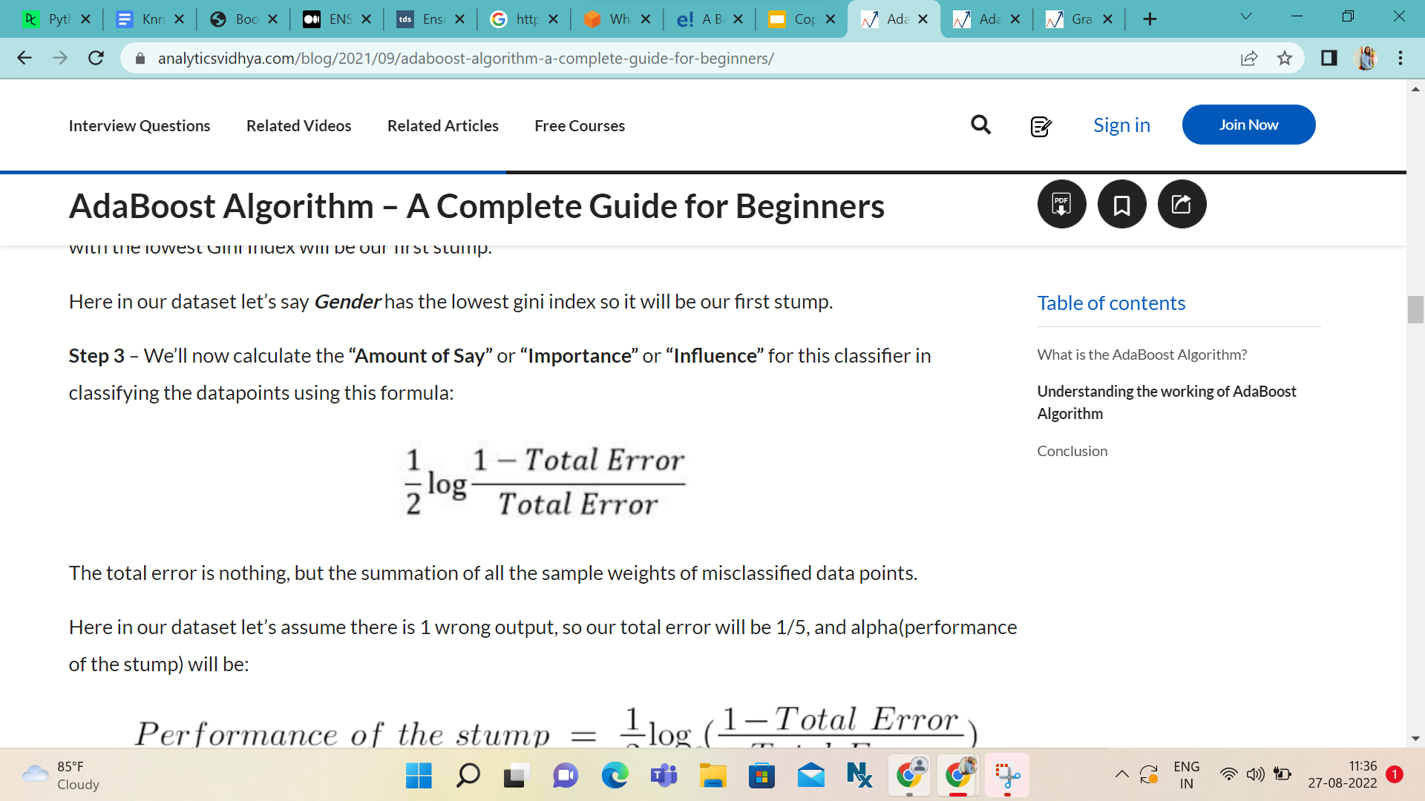
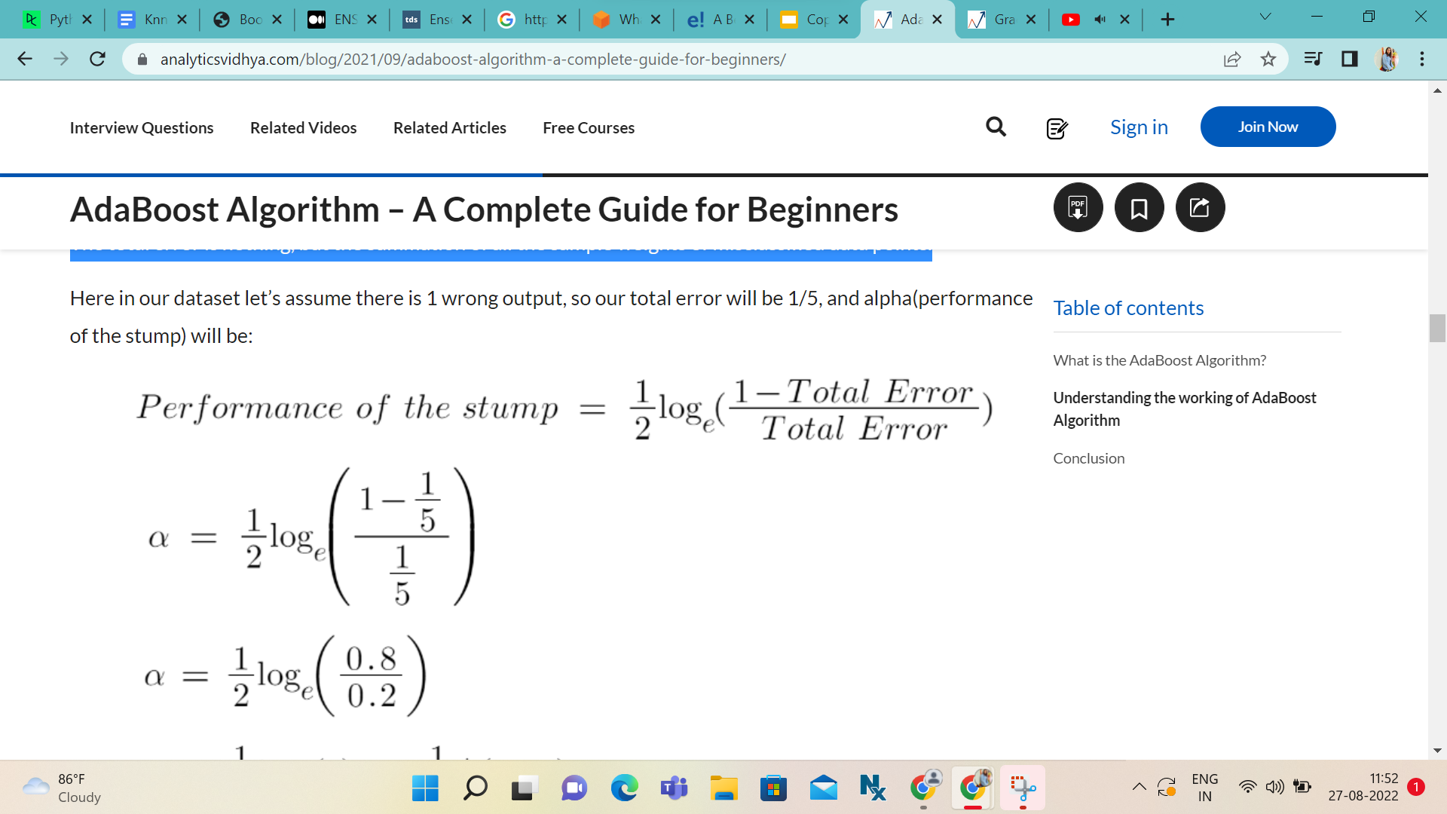
Step 3 – Here we’ll calculate the “Amount of Say” or “Importance” or “Influence” for this classifier in classifying the data points using this formula:
The total error is nothing, but the summation of all the sample weights of misclassified data points.

Slide 31
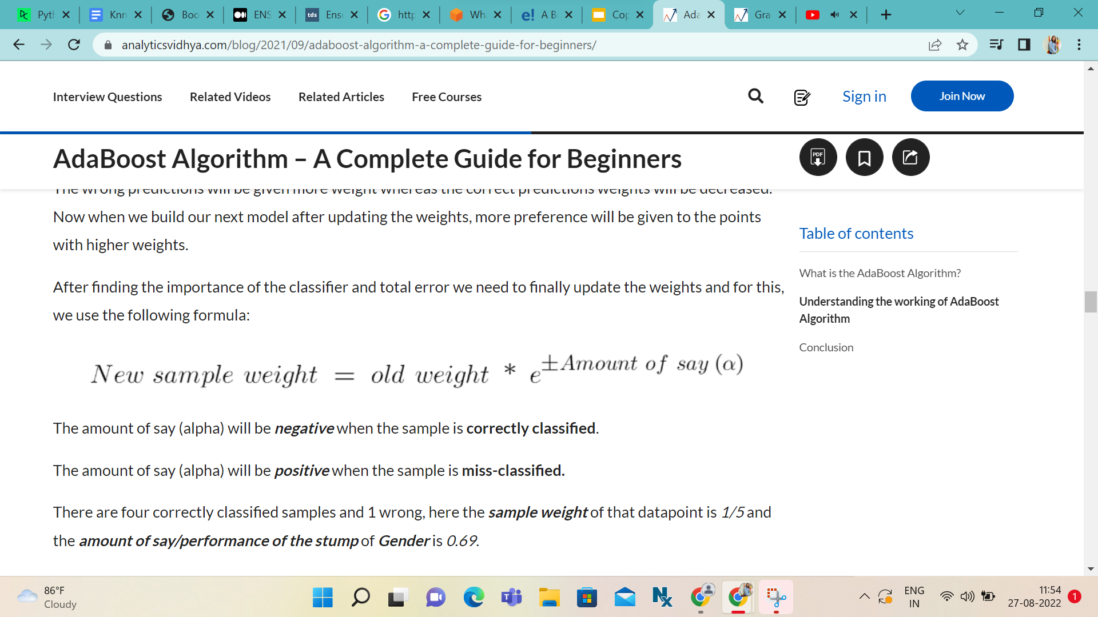
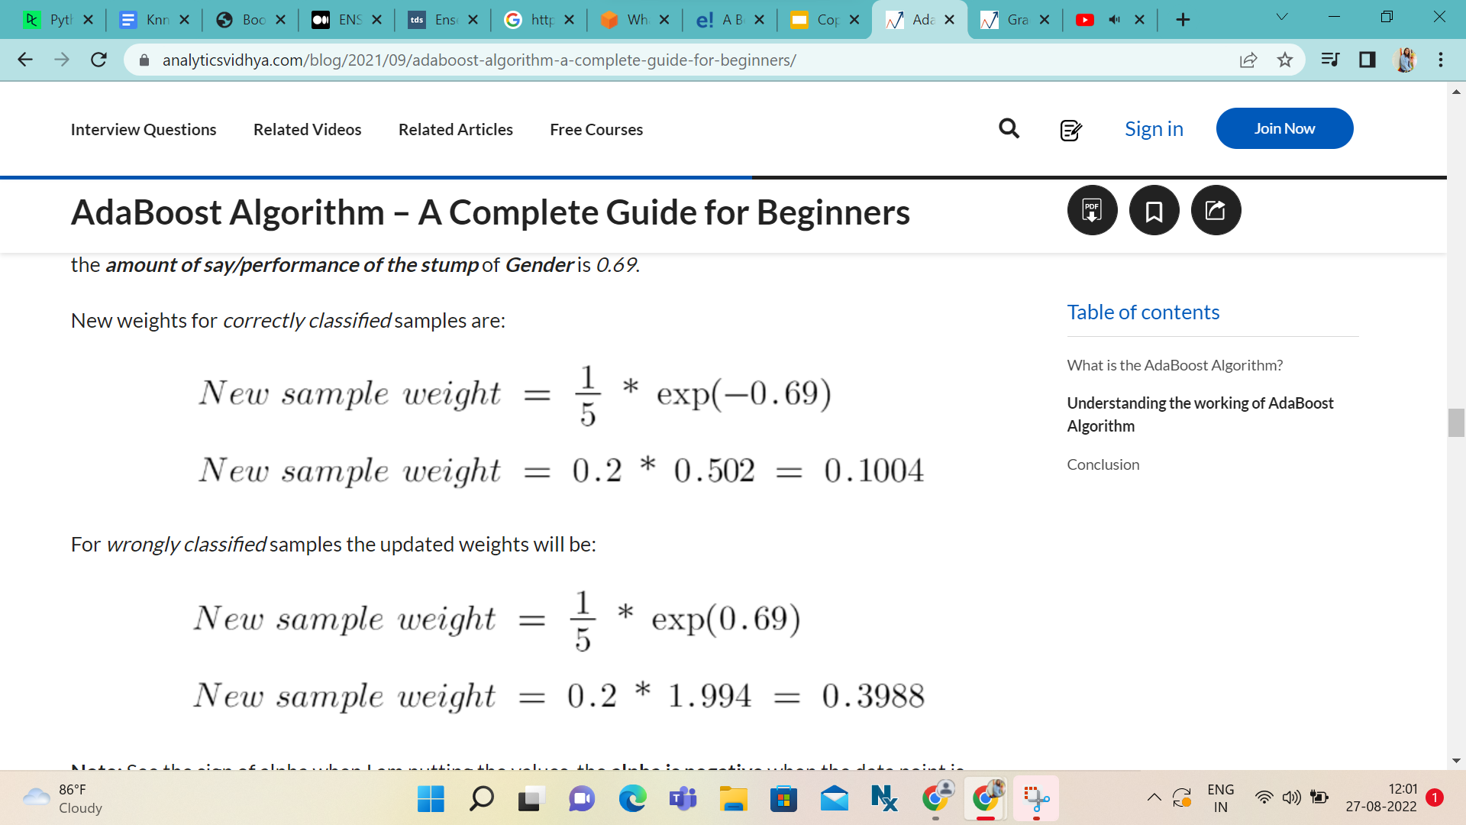
Step 4 - After finding the importance of the classifier and total error we need to finally update the weights and for this, we use the following formula:

Slide 32
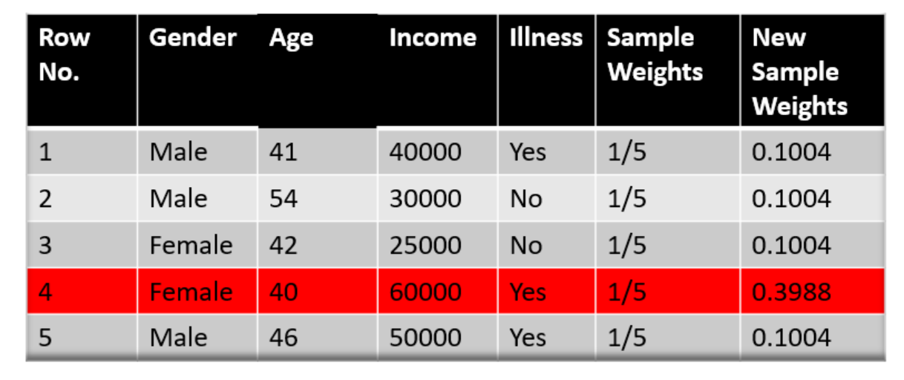
We know that the total sum of the sample weights must be equal to 1 but here if we sum up all the new sample weights, we will get 0.8004.

Slide 33
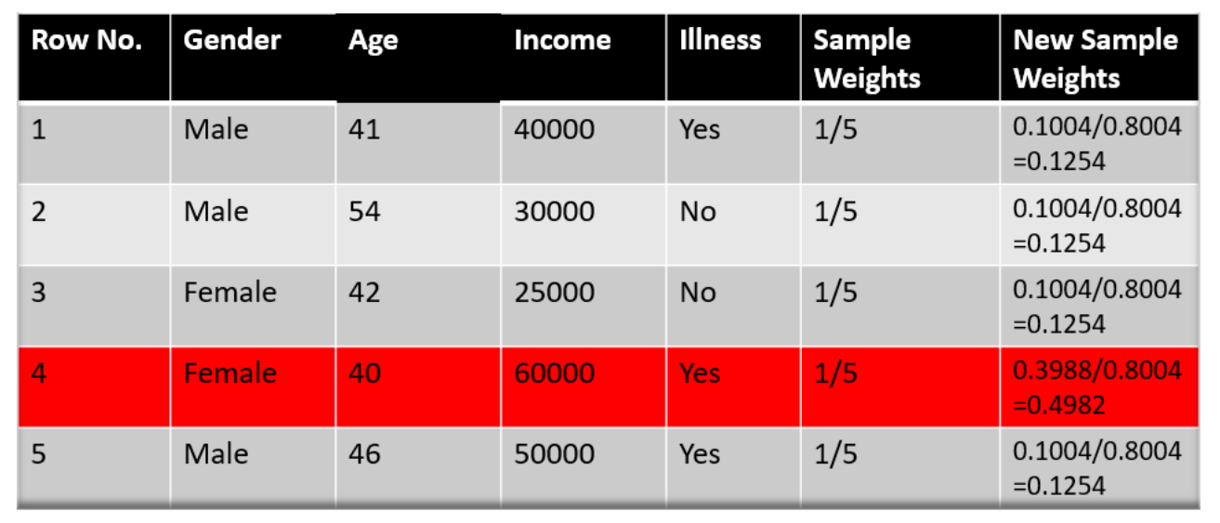
To bring this sum equal to 1 we will normalize these weights by dividing all the weights by the total sum of updated weights that is 0.8004. So, after normalizing the sample weights we get this dataset and now the sum is equal to 1.

Slide 34
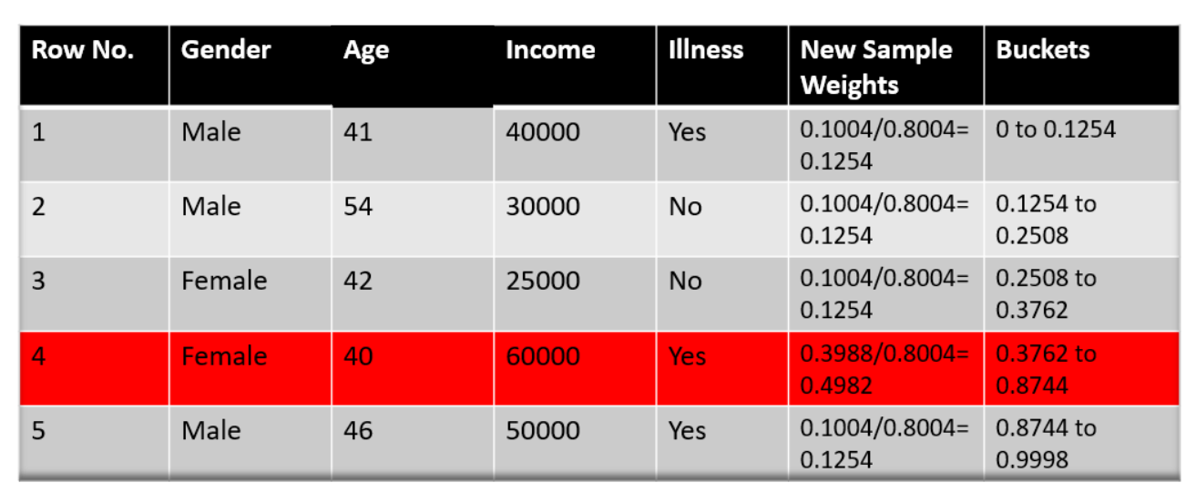
Step 5 – Now we need to make a new dataset to see if the errors decreased or not. For this we will remove the “sample weights” and “new sample weights” column and then based on the “new sample weights” we will divide our data points into buckets.

Slide 35
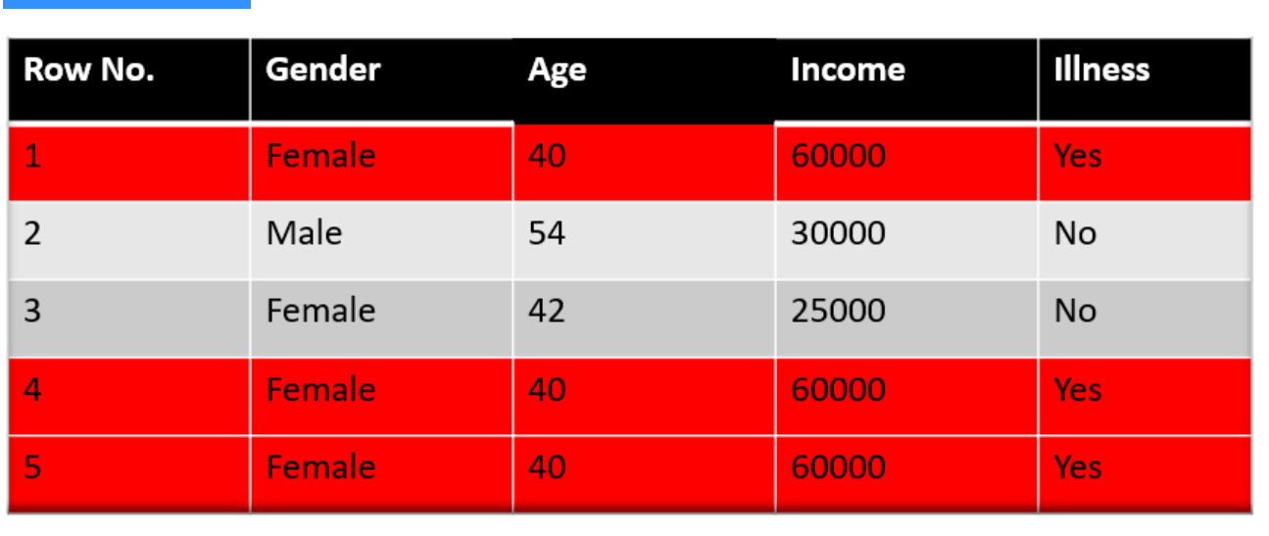
Step 6 – Now what the algorithm does is selects random numbers from 0-1. Since incorrectly classified records have higher sample weights, the probability to select those records is very high.
Suppose the 5 random numbers our algorithm take is 0.38,0.26,0.98,0.40,0.55.
Now we will see where these random numbers fall in the bucket and according to it, we’ll make our new dataset shown below.

Slide 36
This comes out to be our new dataset and we see the datapoint which was wrongly classified has been selected 3 times because it has a higher weight.
Step 7 – Now this act as our new dataset and we need to repeat all the above steps i.e.
Assign equal weights to all the data points.
Find the stump that does the best job classifying the new collection of samples by finding their Gini Index and selecting the one with the lowest Gini index.
Calculate the “Amount of Say” and “Total error” to update the previous sample weights.
Normalize the new sample weights.
Iterate through these steps until and unless a low training error is achieved.
Suppose with respect to our dataset we have constructed 3 decision trees (DT1, DT2, DT3) in a sequential manner. If we send our test data now it will pass through all the decision trees and finally, we will see which class has the majority, and based on that we will do predictions
for our test dataset.

Slide 37
Advantage & Disadvantage
Coming to the advantages, Adaboost is less prone to overfitting as the input parameters are not jointly optimized. The accuracy of weak classifiers can be improved by using Adaboost. Nowadays, Adaboost is being used to classify text and images rather than binary classification problems.
The main disadvantage of Adaboost is that it needs a quality dataset. Noisy data and outliers have to be avoided before adopting an Adaboost algorithm.

Slide 38
2. Gradient Boosting
Gradient Boosting (GB) is similar to AdaBoost, it is also a sequential training technique. The difference between AdaBoost and GB is that GB does not give incorrectly classified items more weight. Instead, GB software optimizes the loss function by generating base learners sequentially so that the present base learner is always more effective than the previous one. This method attempts to generate accurate results initially instead of correcting errors throughout the process, like AdaBoost. For this reason, GB software can lead to more accurate results.

Slide 39
Gradient Boosting can help with both classification and regression-based problems. When the target column is continuous, we use Gradient Boosting Regressor whereas when it is a classification problem, we use Gradient Boosting Classifier. The only difference between the two is the “Loss function”.
The objective here is to minimize this loss function by adding weak learners using gradient descent. Since it is based on loss function hence for regression problems, we’ll have different loss functions like Mean squared error (MSE) and for classification, we will have different for e.g log-likelihood.

Slide 40
Gradient Boosting has three component -
Loss Function - The role of the loss function is to estimate how good the model is at making predictions with the given data. This could vary depending on the problem at hand.
For example, if we're trying to predict the weight of a person depending on some input variables (a regression problem), then the loss function would be something that helps us find the difference between the predicted weights and the observed weights. On the other hand, if we're trying to categorize if a person will like a certain movie based on their personality, we'll require a loss function that helps us understand how accurate our model is at classifying people who did or didn't like certain movies.

Slide 41
Weak Learner - A weak learner is one that classifies our data but does so poorly, perhaps no better than random guessing. In other words, it has a high error rate. These are typically decision trees (also called decision stumps, because they are less complicated than typical decision trees).
Additive Model - This is the iterative and sequential approach of adding the trees (weak learners) one step at a time. After each iteration, we need to be closer to our final model. In other words, each iteration should reduce the value of our loss function.

Slide 42
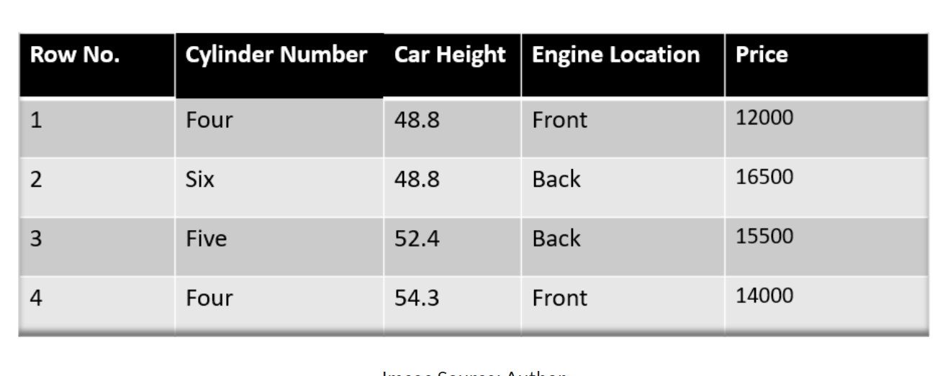
Using An Example To Explain The Algorithm
Our target column is continuous so we will use Gradient Boosting Regressor.
We have sample of a random dataset where we have to predict the car price based on various features. The target column is price and other features are independent features.

Slide 43
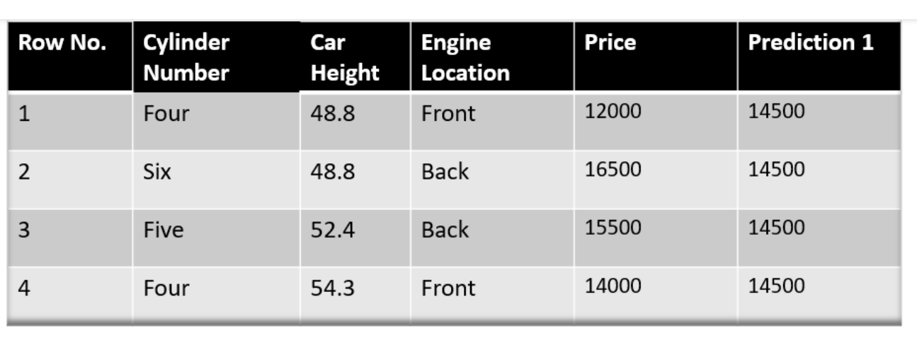
Step -1 The first step in gradient boosting is to build a base model to predict the observations in the training dataset. For simplicity we take an average of the target column and assume that to be the predicted value as shown below:

Slide 44
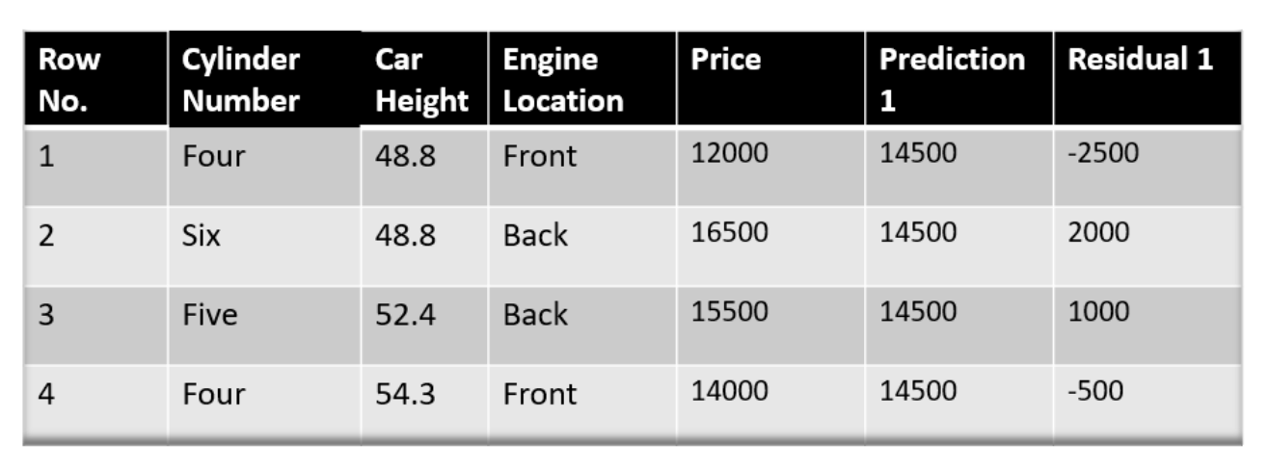
Step-2 The next step is to calculate the pseudo residuals which are (observed value – predicted value)

Slide 45
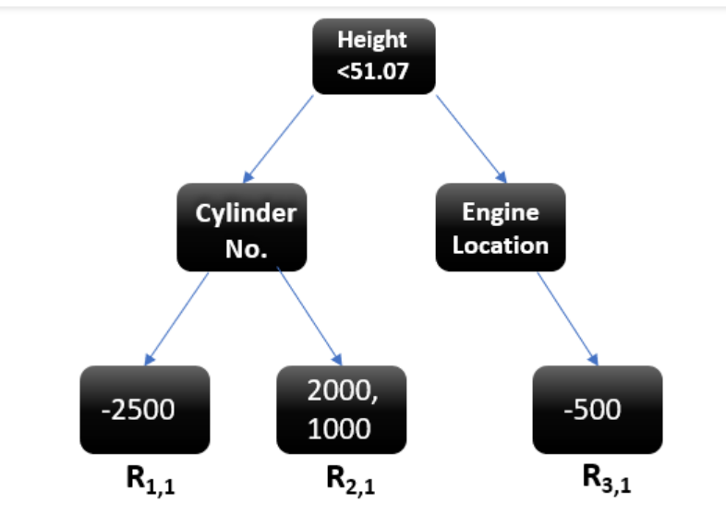
Step 3- We will build a model on these pseudo residuals and make predictions. Because we want to minimize these residuals and minimizing the residuals will eventually improve our model accuracy and prediction power.

Slide 46
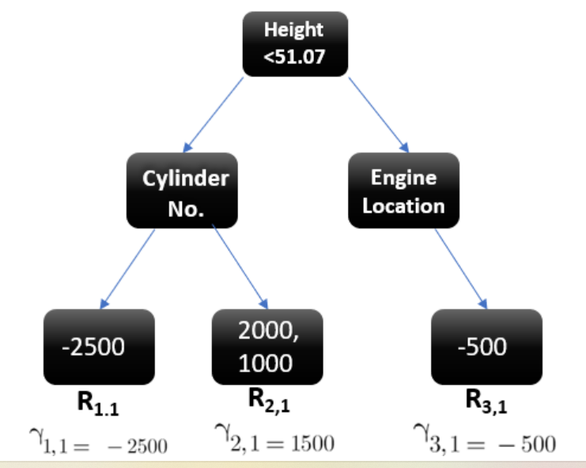
Step 4 -In this step we find the output values for each leaf of our decision tree. That means there might be a case where 1 leaf gets more than 1 residual, hence we need to find the final output of all the leaves.
To find the output we can simply take the average of all the numbers in a leaf, doesn’t matter if there is only 1 number or more than 1.

Slide 47
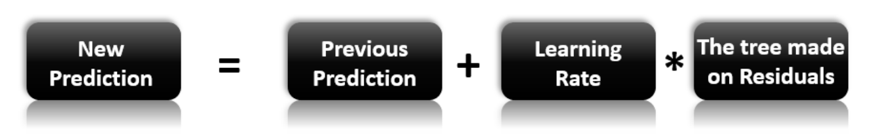
Step-5 This is finally the last step where we have to update the predictions of the previous model.

Slide 48
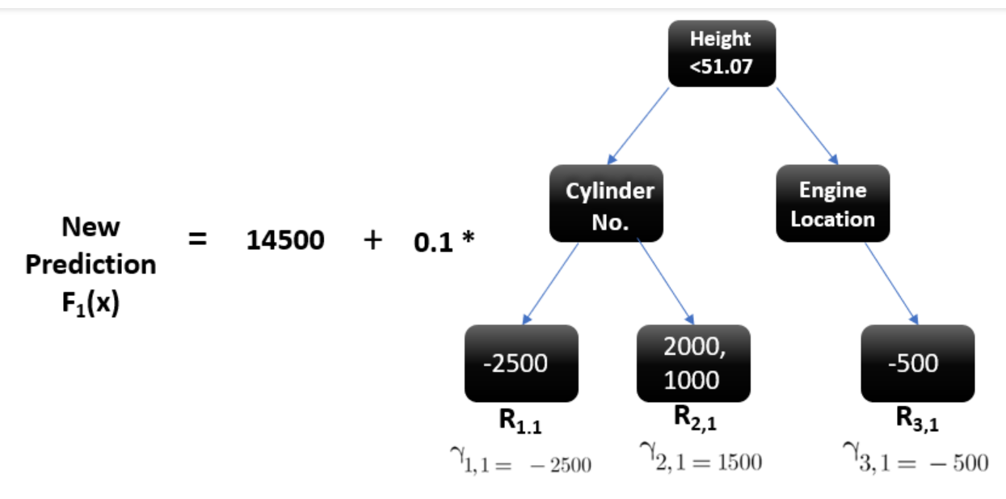
Let’s calculate the new prediction now -
Suppose we want to find a prediction of our first data point which has a car height of 48.8. This data point will go through this decision tree and the output it gets will be multiplied with the learning rate and then added to the previous prediction.

Slide 49
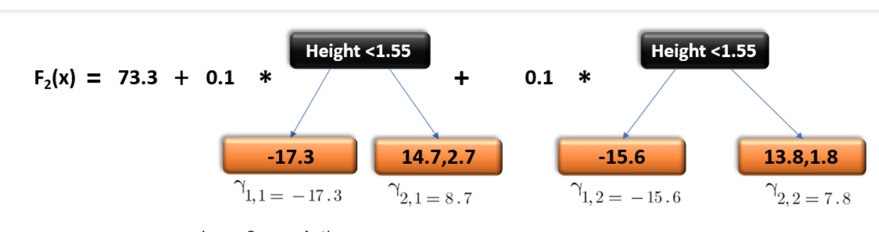
Now let’s say m=2 which means we have built 2 decision trees and now we want to have new predictions.
This time we will add the previous prediction that is F1(x) to the new DT made on residuals. We will iterate through these steps again and again till the loss is negligible.
To make you understand how this predicts for a new dataset:

Slide 50
Advantage of Gradient Boosting
Often provides predictive accuracy that cannot be trumped.
Lots of flexibility - can optimize on different loss functions and provides several hyper parameter tuning options that make the function fit very flexible.
No data pre-processing required - often works great with categorical and numerical values as is.
Handles missing data - imputation not required.

Slide 51
Disadvantage of Gradient Boosting
Gradient Boosting Models will continue improving to minimize all errors. This can overemphasize outliers and cause overfitting.
Computationally expensive - often require many trees (>1000) which can be time and memory exhaustive.
The high flexibility results in many parameters that interact and influence heavily the behavior of the approach (number of iterations, tree depth, regularization parameters, etc.). This requires a large grid search during tuning.
Less interpretative in nature, although this is easily addressed with various tools.

Slide 52
3. XGBoost
Extreme Gradient Boosting (XGBoost) improves gradient boosting for computational speed and scale in several ways. XGBoost uses multiple cores on the CPU so that learning can occur in parallel during training. It is a boosting algorithm that can handle extensive datasets, making it attractive for big data applications. The key features of XGBoost are parallelization, distributed computing, cache optimization, and out-of-core processing.

Slide 53
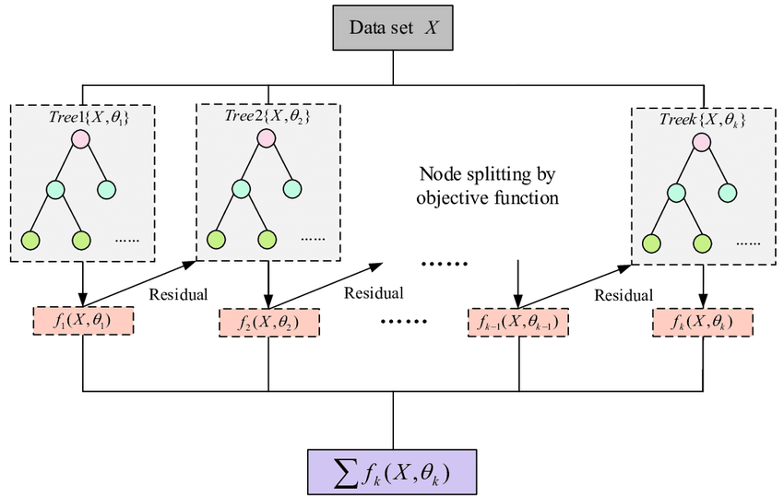
Diagram of XGBoost

Slide 54
When To Use XGBoost ?
When you have large number of observations in training data.
Number features < number of observations in training data.
It performs well when data has mixture numerical and categorical features or just numeric features.
When the model performance metrics are to be considered.

Slide 55
Features of XGBoost
Regularization: XGBoost has an option to penalize complex models through both L1 and L2 regularization. Regularization helps in preventing overfitting.
Handling sparse data: Missing values or data processing steps like one-hot encoding make data sparse. XGBoost incorporates a sparsity-aware split finding algorithm to handle different types of sparsity patterns in the data.
Weighted quantile sketch: Most existing tree based algorithms can find the split points when the data points are of equal weights (using quantile sketch algorithm). However, they are not equipped to handle weighted data. XGBoost has a distributed weighted quantile sketch algorithm to effectively handle weighted data.

Slide 56
Features of XGBoost
Block structure for parallel learning: For faster computing, XGBoost can make use of multiple cores on the CPU. This is possible because of a block structure in its system design. Data is sorted and stored in in-memory units called blocks. Unlike other algorithms, this enables the data layout to be reused by subsequent iterations, instead of computing it again. This feature also serves useful for steps like split finding and column sub-sampling.
Cache awareness: In XGBoost, non-continuous memory access is required to get the gradient statistics by row index. Hence, XGBoost has been designed to make optimal use of hardware. This is done by allocating internal buffers in each thread, where the gradient statistics can be stored
Out-of-core computing: This feature optimizes the available disk space and maximizes its usage when handling huge datasets that do not fit into memory.

Slide 57
Working Of XGBoost Algorithm
When using gradient boosting for regression, the weak learners are regression trees, and each regression tree maps an input data point to one of its leafs that contains a continuous score.
XGBoost minimizes a regularized (L1 and L2) objective function that combines a convex loss function (based on the difference between the predicted and target outputs) and a penalty term for model complexity (in other words, the regression tree functions).
The training proceeds iteratively, adding new trees that predict the residuals or errors of prior trees that are then combined with previous trees to make the final prediction. It's called gradient boosting because it uses a gradient descent algorithm to minimize the loss when adding new models.

Slide 58
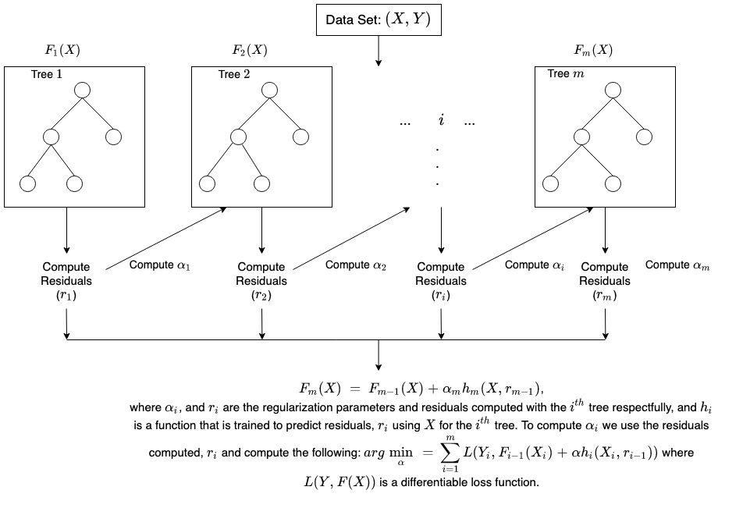

Slide 59
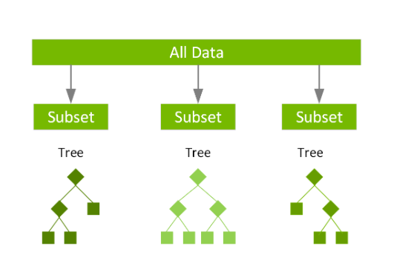
With XGBoost, trees are built in parallel, instead of sequentially . It follows a level-wise strategy, scanning across gradient values and using these partial sums to evaluate the quality of splits at every possible split in the training set.

Slide 60
XGBoost Benefits and Attribute
The list of benefits and attributes of XGBoost is extensive, and includes the following:
A large and growing list of data scientists globally that are actively contributing to XGBoost open source development
Usage on a wide range of applications, including solving problems in regression, classification, ranking, and user-defined prediction challenges
A library that’s highly portable and currently runs on OS X, Windows, and Linux platforms
Cloud integration that supports AWS, Azure, Yarn clusters, and other ecosystems
Active production use in multiple organizations across various vertical market areas
A library that was built from the ground up to be efficient, flexible, and portable

Slide 61
Advantage
It is Highly Flexible
It uses the power of parallel processing
It is faster than Gradient Boosting
It supports regularization
It is designed to handle missing data with its in-build features.
The user can run a cross-validation after each iteration.
It Works well in small to medium dataset

Slide 62
Disadvantage
XGBoost does not perform so well on sparse and unstructured data.
A common thing often forgotten is that Gradient Boosting is very sensitive to outliers since every classifier is forced to fix the errors in the predecessor learners.
The overall method is hardly scalable. This is because the estimators base their correctness on previous predictors, hence the procedure involves a lot of struggle to streamline.

Slide 63
3.3
Stacking

Slide 64
3. Stacking
Stacking mainly differ from bagging and boosting on two points.
First stacking often considers heterogeneous weak learners (different learning algorithms are combined) whereas bagging and boosting consider mainly homogeneous weak learners.
Second, stacking learns to combine the base models using a meta-model whereas bagging and boosting combine weak learners following deterministic algorithms.

Slide 65
Architecture of Stacking
The architecture of the stacking model is designed in such as way that it consists of two or more base/learner's models and a meta-model that combines the predictions of the base models.
These base models are called level 0 models, and the meta-model is known as the level 1 model. So, the Stacking ensemble method includes original (training) data, primary level models, primary level prediction, secondary level model, and final prediction.

Slide 66
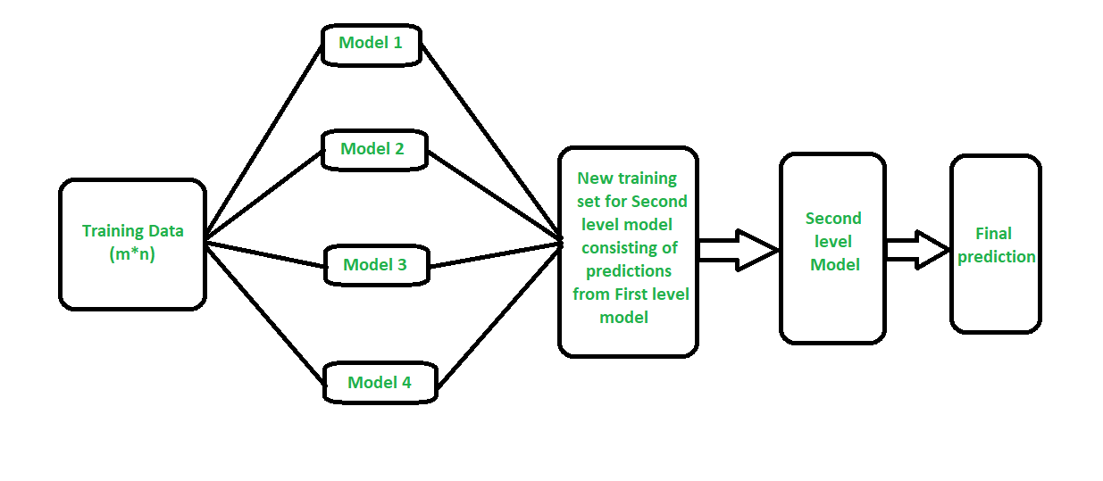
Diagram of Stacking Algorithm

Slide 67
Original data: This data is divided into n-folds and is also considered test data or training data.
Base models: These models are also referred to as level-0 models. These models use training data and provide compiled predictions (level-0) as an output.
Level-0 Predictions: Each base model is triggered on some training data and provides different predictions, which are known as level-0 predictions.
Meta Model: The architecture of the stacking model consists of one meta-model, which helps to best combine the predictions of the base models. The meta-model is also known as the level-1 model.
Level-1 Prediction: The meta-model learns how to best combine the predictions of the base models and is trained on different predictions made by individual base models, i.e., data not used to train the base models are fed to the meta-model, predictions are made, and these predictions, along with the expected outputs, provide the input and output pairs of the training dataset used to fit the meta-model.

Slide 68
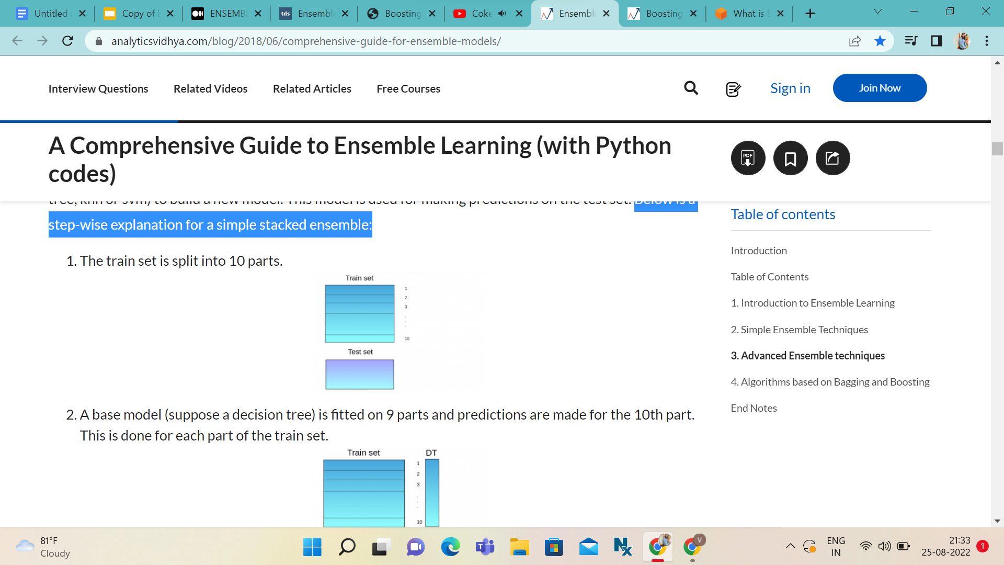
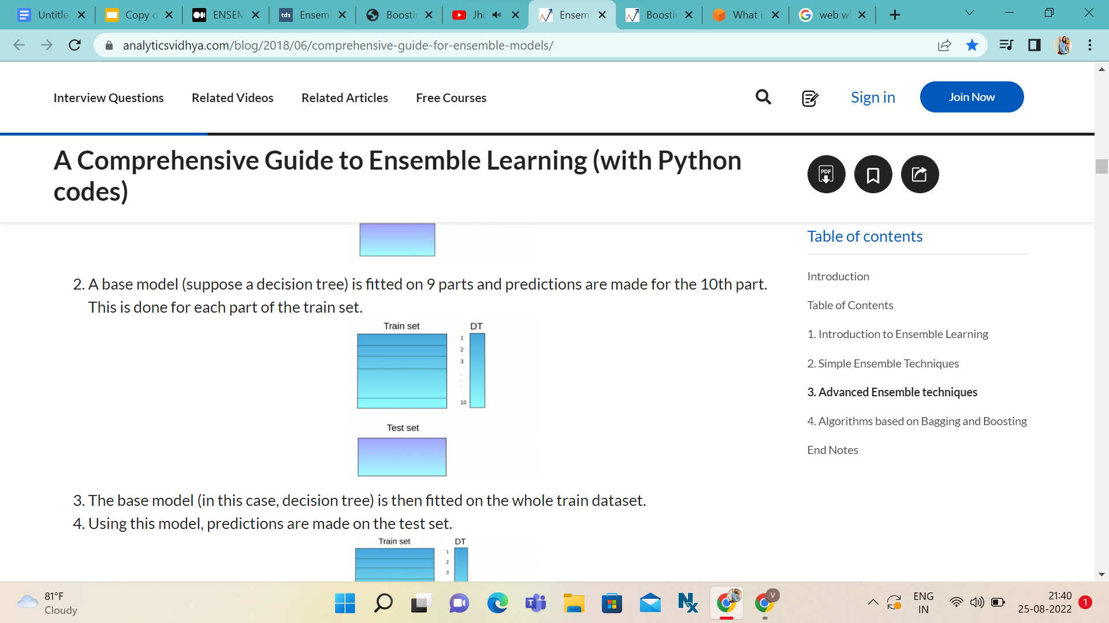
How does Stacking work?
Below is a step-wise explanation for a simple stacked ensemble:
The train set is split into 10 parts
2. A base model (suppose a decision tree) is fitted on 9 parts and predictions are made for the 10th part. This is done for each part of the train set.

Slide 69
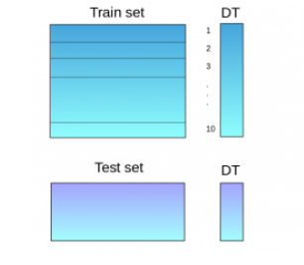
3. The base model (in this case, decision tree) is then fitted on the whole train dataset.
4. Using this model, predictions are made on the test set.

Slide 70
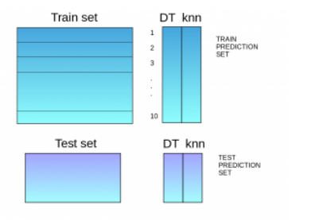
5. Steps 2 to 4 are repeated for another base model (say knn) resulting in another set of predictions for the train set and test set.

Slide 71
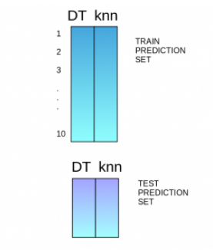
6. The predictions from the train set are used as features to build a new model
7. This model is used to make final predictions on the test prediction set
Stacking, just like other ensemble techniques, tries to improve the accuracy of a model by using predictions of not so good models and then using those predictions as an input feature for a better model.

Slide 72
Advantage
Disadvantage
1. The benefit of stacking is that it can harness the capabilities of a range of well-performing models on a classification or regression task and make predictions that have better performance than any single model in the ensemble.
2. Stacking improves the model prediction accuracy.
1. As we are taking the whole dataset for training for every individual classifier, in the case of huge datasets the computational time will be more as each classifier is working independently on the huge dataset.

Slide 73
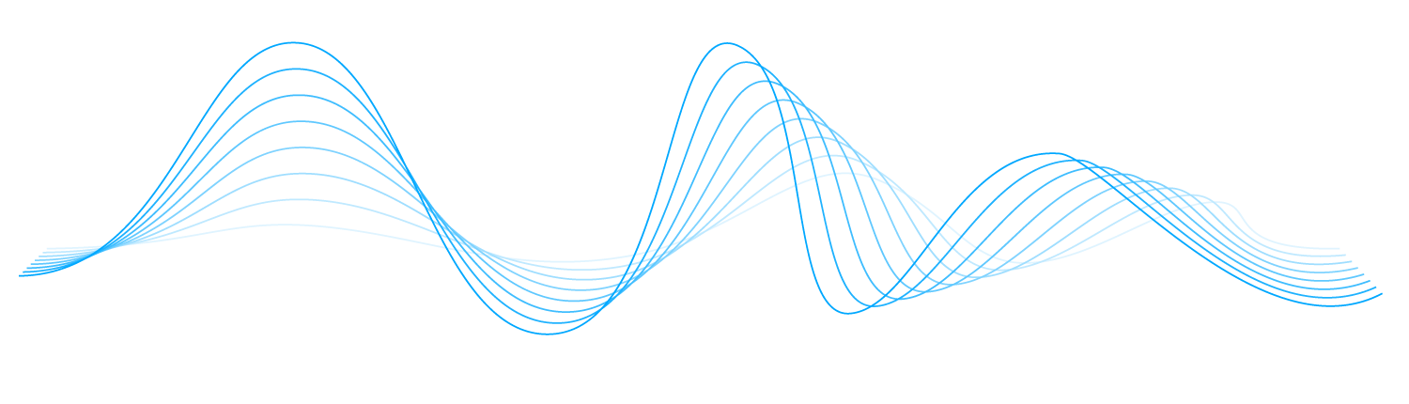
Thank You

